Slide 1

ECE 281 Lesson 28
1

Slide 2
Lesson 28 Outline
Do Time Logs!
On the Horizon:
Lab 3 Report and Additional Functionalities (LSN 29 - COB)
Architecture
Memory Addressing
MIPS
Assembly Language Programming

Slide 3
Where we are going…
Abstraction
Where we have been…

Slide 4
Assembly and Machine Languages
Instructions:
words in a computers language
Instruction Set:
the dictionary of the language
Assembly Language:
human-readable format of computer instructions
Machine Language:
computer-readable instructions - binary (1's and 0's)
Assembly Language Program
Assembler
Relocatable Object Code
Linker
Executable Code

Slide 5
Steps for Translating and starting a program
Higher Level Language (HLL)
Compiler
Assembly Language
Assembler
Object File (Machine Code)
Object Files
Library Files
Linker
Executable
Loader
Memory

Slide 6
Architecture vs Micro-Architecture
Architecture: the programmer’s view of the computer
Defined by instruction set and operand locations (i.e. registers, instructions, and memory)
Examples – x86, ARM, PowerPC, and MIPS
Micro-architecture: hardware implementation of architecture
Specific arrangement of registers, memories, ALUs etc.
Many different microarchitectures exist for a single architecture

Slide 7
Architecture
Any Architecture will consist of:
A set of operations (instructions)
Data units (sizes, addressing modes, etc.)
Registers
Interaction with memory
Program counter

Slide 8
Von Neuman vs Harvard
Harvard architecture physically separates signals and storage for code and data
i.e., separate memory for data and instructions

Slide 9
Computer Block Diagram
CPU
Memory
Input/
Output
Outside
World
Control
Datapath
ALU
Control Bus
Data Bus
Address Bus

Slide 10
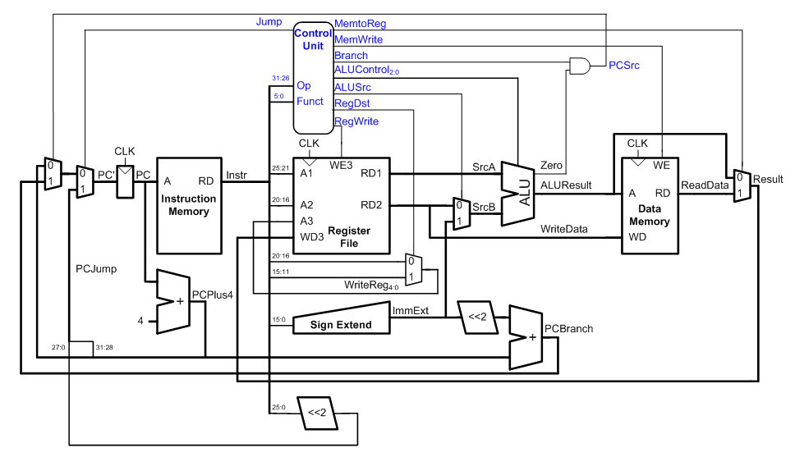
Single Cycle MIPS Arch (Harvard)

Slide 11
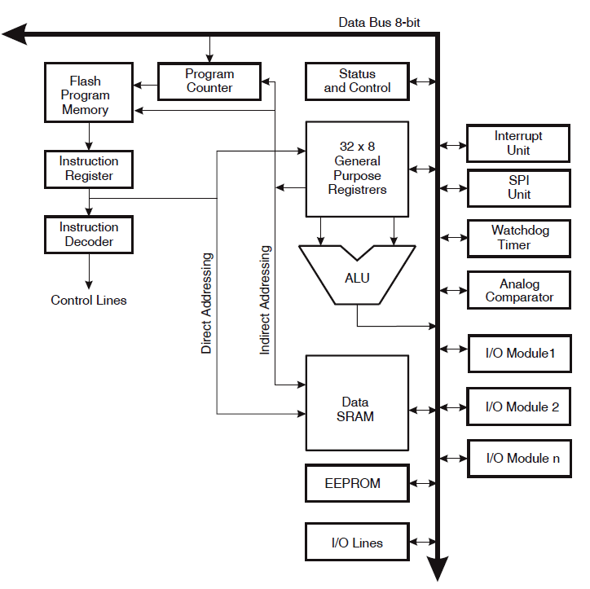
Atmega 328-P (Harvard) Arch

Slide 12
MIPS Architecture
The MIPS Architecture consists of:
A set of operations (instructions)
I-Type, R-Type, J-Type
Data units (sizes, addressing modes, etc.)
32-Bit Data Word
Registers
32, 32-bit registers
Interaction with memory
Harvard Architecture
Load and Store
Program counter
32-bit PC

Slide 13
Design Principles
Simplicity favors regularity
Make a common case fast
Smaller is faster
Good design demands good compromises

Slide 14
Components of Computer Architecture
CPU – Central Processing Unit
Controller – makes other components work together
Datapath – does computations; keep track of where we are. What are we tracking?
Program Counter
Memory – Stores information (code and data)
Address – where info is located
Data – what info is
I/O – data goes in/out to/from the outside world

Slide 15
Computer Block Diagram
CPU
Memory
Input/
Output
Outside
World
Control
Datapath
ALU
Control Bus
Data Bus
Address Bus

Slide 16
Computer Block Diagram
ALU

Slide 17
CISC vs RISC
RISC
Reduced Instruction Set Computer
CISC
Complex Instruction Set Computer
Tradeoffs RISC vs CISC
more instructions == more complex hardware
Complex
SW
Complex
HW

Slide 18
Assembly Code
Mnemonic – name of an operation/instruction
Opcode – binary representation of mnemonic
Operand – target of operation/instruction
lw $s3, 4($0)
➔ 100011 (found in Appendix B of book)
MIPS Architecture:
$ indicates a register
32 Registers
32 bits in a word
$0 $t $s
Mnemonic
Operands
Opcode

Slide 19
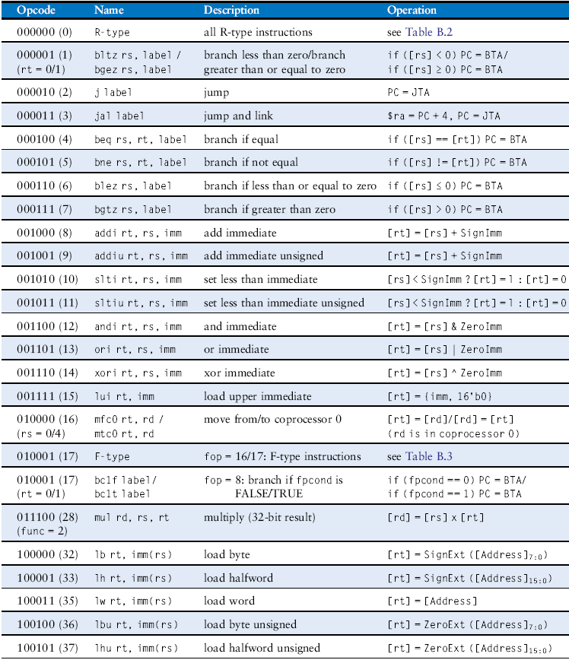
MIPS Instruction Set
Table B.1 Instructions, sorted by opcode
Copyright © 2013 Elsevier Inc. All rights reserved.

Slide 20
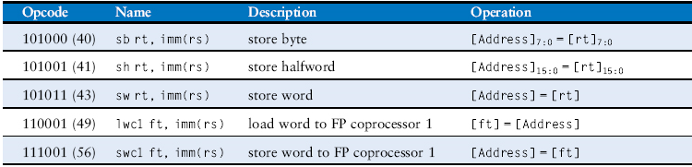
MIPS Instruction Set
Table B.1 Instructions, sorted by opcode
Copyright © 2013 Elsevier Inc. All rights reserved.

Slide 21
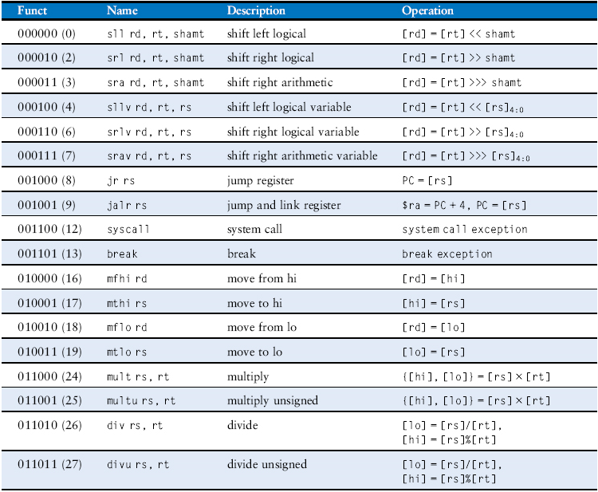
MIPS Instruction Set
Table B.2 R-type instructions, sorted by funct field
Copyright © 2013 Elsevier Inc. All rights reserved.

Slide 22
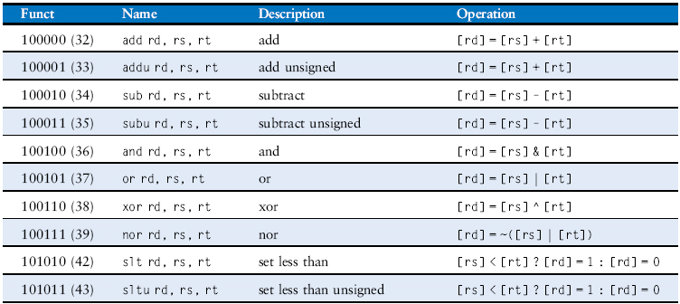
MIPS Instruction Set
Table B.2 R-type instructions, sorted by funct field
Copyright © 2013 Elsevier Inc. All rights reserved.

Slide 23
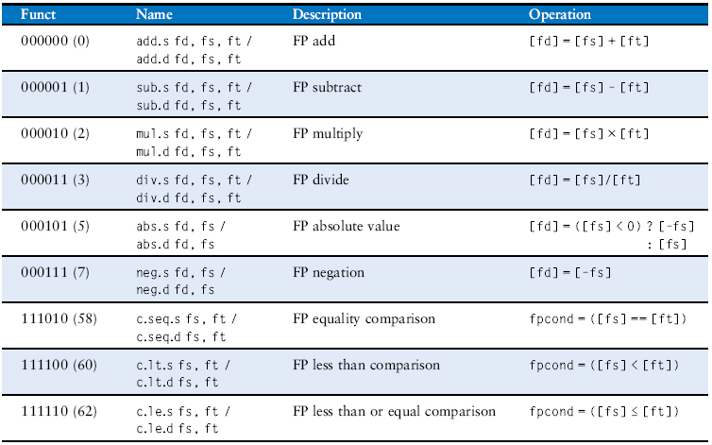
MIPS Instruction Set
Table B.3 F-type instructions (fop = 16/17)
Copyright © 2013 Elsevier Inc. All rights reserved.

Slide 24
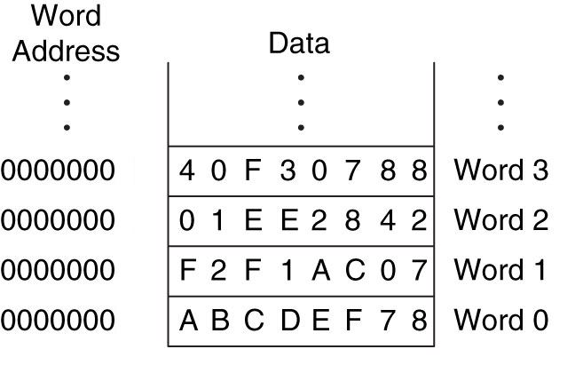
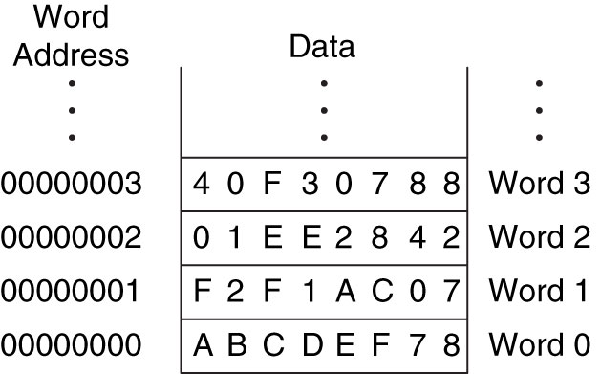
Word-addressable Memory
width = 1 word (32-Bits)
width =
Figure 6.1 Word-addressable memory
Copyright © 2013 Elsevier Inc. All rights reserved.

Slide 25
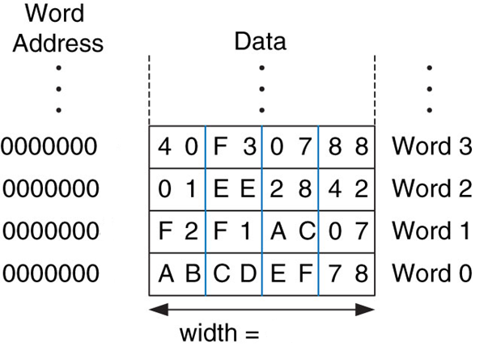
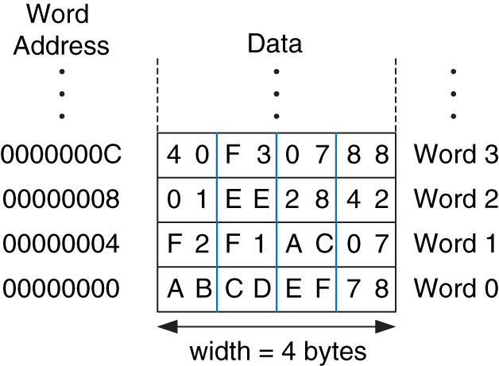
Byte-Addressable Memory
MIPS
Figure 6.2 Byte-addressable memory
Copyright © 2013 Elsevier Inc. All rights reserved.

Slide 26
Big/Little Endian Byte Storage
There are two storage conventions: big endian and little endian
The value ABCD1234H would be stored as shown below for the different storage conventions
The name big/little endian answers the question: “What is stored in Byte #0?”
Byte zero holds Little Endian of the word
0
0
1
1
0
1
0
0
0
0
0
1
0
0
1
0
1
1
0
0
1
1
0
1
1
0
1
0
1
0
1
1
(34)
(12)
(CD)
(AB)
Low Order Byte
(Byte #0)
Byte #1
Byte #2
High Order Byte
(Byte #3)
Byte zero holds Big Endian of the word
1
0
1
0
1
0
1
1
1
1
0
0
1
1
0
1
0
0
0
1
0
0
1
0
0
0
1
1
0
1
0
0
(AB)
(CD)
(12)
(34)
Low Order Byte
(Byte #0)
Byte #1
Byte #2
High Order Byte
(Byte #3)

Slide 27
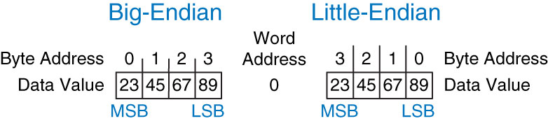
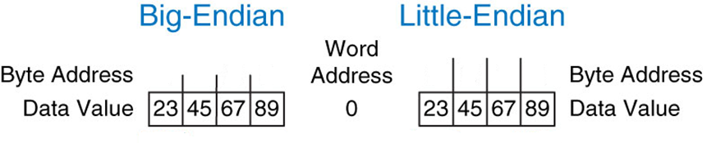
Big-Endian vs Little-Endian
Big-Endian – Byte numbering starts @ MSB
Little-Endian – Byte numbering starts @ LSB
0x23456789
Figure 6.4 Big-endian and little-endian data storage
Copyright © 2013 Elsevier Inc. All rights reserved.

Slide 28
Little-Endian
Given: $t0 = 0x23456789
What gets stored in $s0 in this assembly code?
sw $t0, 0($0)
lb $s0, 1($0)
$t0 =
$t0 =
 | 3 | 2 | 1 | 0
$t0 = | 23 | 45 | 67 | 89
 | 3 | 2 | 1 | 0

Slide 29
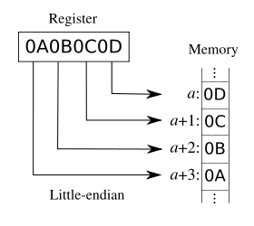
MIPS Architecture Uses Little Endian
Values stored in little-endian byte order
Least significant byte is stored first
5000
5001
5002
5003

Slide 30

30

